Slide 1


PREDICTING
GRADE 12 STEM
ENROLLMENT
ACROSS PHILIPPINE SCHOOLS
USING MACHINE LEARNING

Slide 2
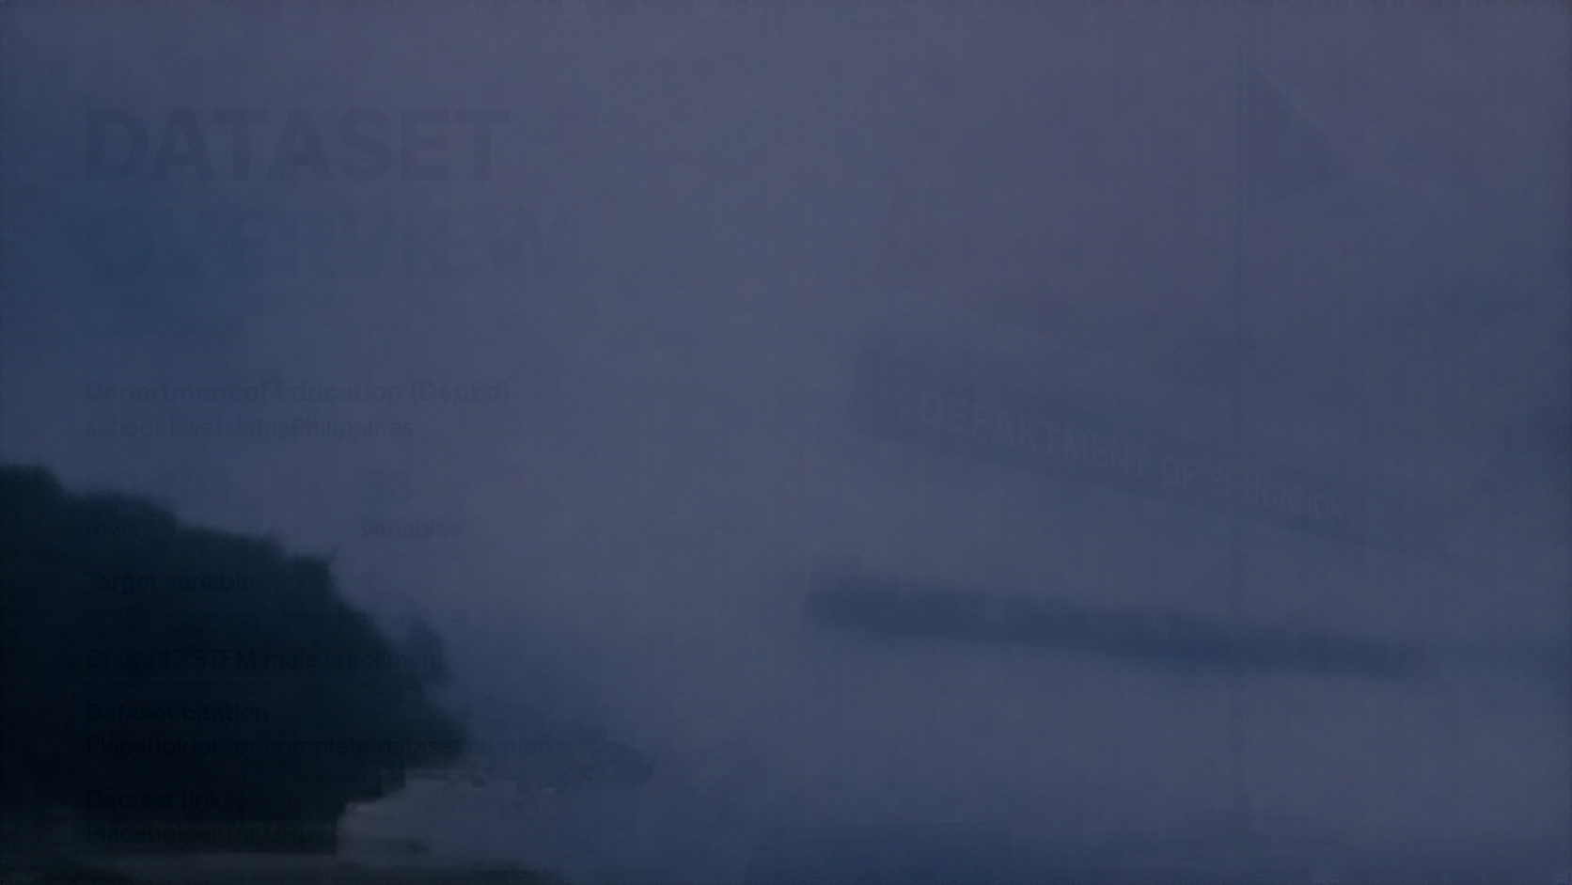



DATASET
OVERVIEW
Department of Education (DepEd)
school-level data, Philippines
60,204
83
rows
variables
Target variable
g12_stem_male
Grade 12 STEM male enrollment
Dataset link
deped.gov.ph

Slide 3



PREDICTION
PROBLEM
Estimate the number of Grade 12 STEM male enrollees at each school
Target variable: g12_stem_male
Task type: supervised learning, regression
Intended use: early warning and resource forecasting for DepEd planners based on previous-year track uptake

Slide 4
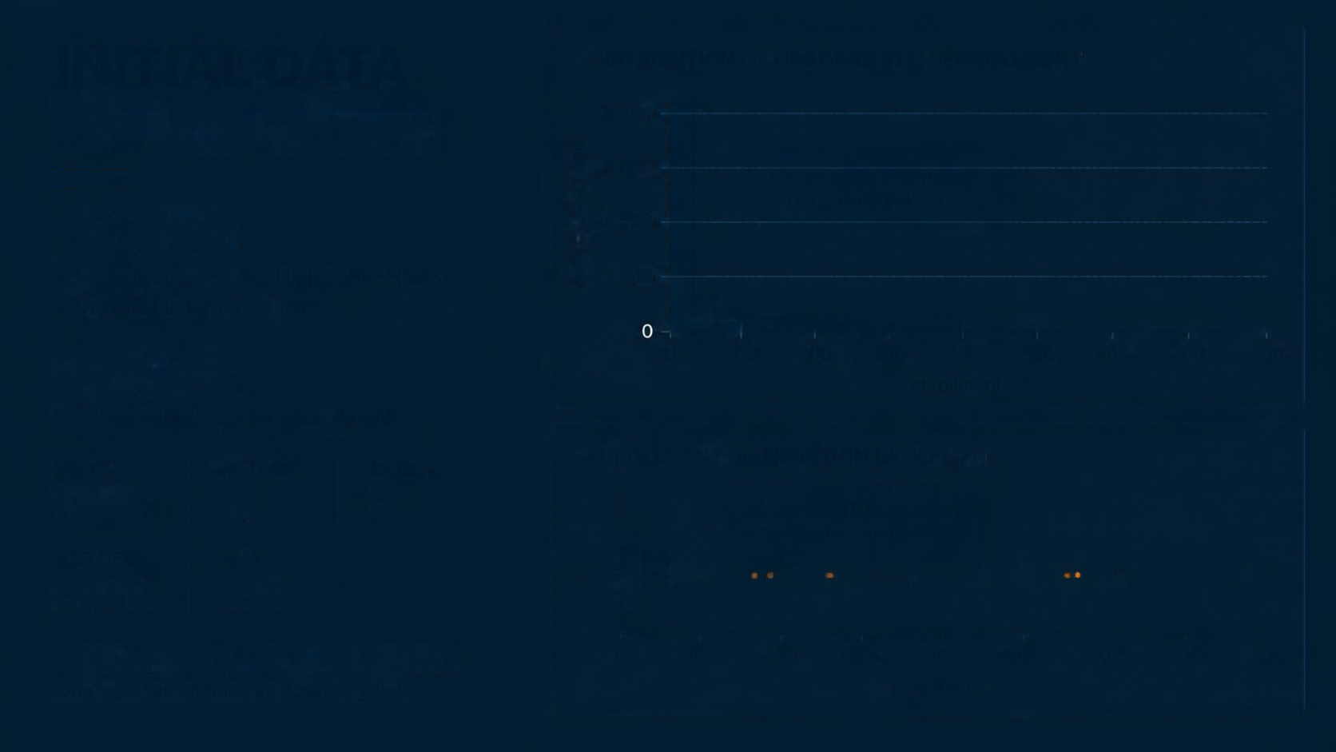

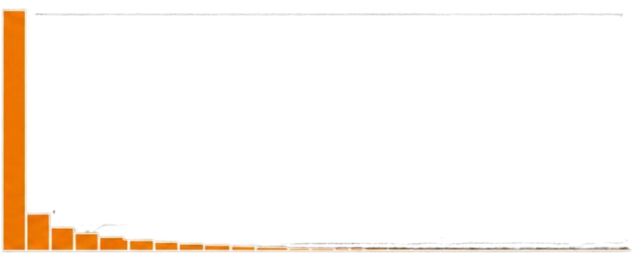
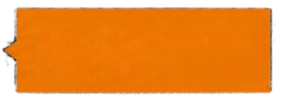

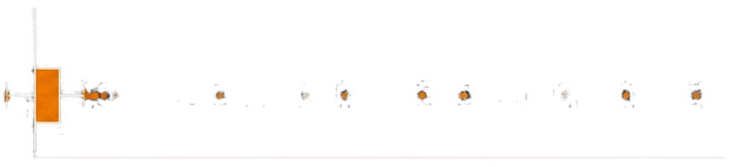

INITIAL DATA
DISTRIBUTION OF GRADE 12 STEM ENROLLMENT
EXPLORATION
8,000
6,000
large spike at zero with a long right tail
12,852
number of schools
4,000
schools offering Senior High School (SHS) with available target values
2,000
61.97%
0 100 200 300 400 500 600 700 800
7,965 schools have zero enrollment
MEAN
MEDIAN
MODE
ENROLLMENT DISTRIBUTION (BOX PLOT)
13.72
0
0
compressed IQR near zero with extreme outliers
STD DEV
MAX
37.50
717
ZERO-INFLATED AND RIGHT-SKEWED
0 100 200 300 400 500 600 700 800
long right tail retained as possibly valid

Slide 5













PREPROCESSING
PLAN
From raw records to a clean, leakage-free dataset ready for machine learning.
RAW
DATA
FILTER &
CLEAN
PREVENT
LEAKAGE
IMPUTE & ENCODE
REFINE
FEATURES
MODELING
DATASET
Complete DepEd
school-level records
Keep SHS schools
Remove missing target values
Drop school
identifiers and
Grade 12 variables
Median imputation for numeric
Mode imputation for categorical
Dummy encoding
Remove zero-variance predictors
Clean, consistent, and ready for
Random Forest modeling
NO FEATURE SCALING
Random Forest is insensitive to monotonic scaling.

Slide 6
MISSING
DATA CHALLENGE
HIGH VOLUME OF MISSING VALUES
78.65%.
Out of 60, 204 total rows, 47, 352 entries are missing for g12_stem_male.
DATA CONTEXT INSIGHT
In the context of DepEd data, these missing values likely represent junior high schools, elementary schools, or senior high schools that do not offer the STEM strand (structural zeros/non-offerings).
FIX
Do not simply impute these NAs with the mean or median. If a school doesn't offer STEM, including them as zeroes or missing rows can heavily bias your training process.

Slide 7


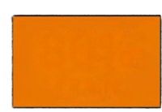
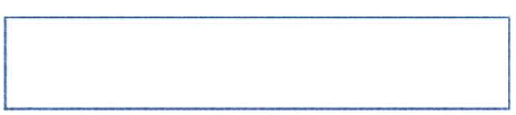

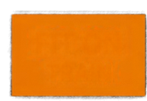
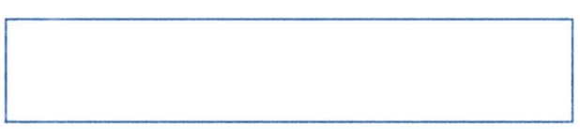

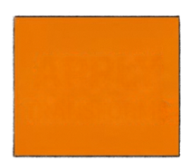
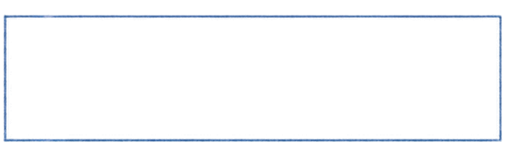

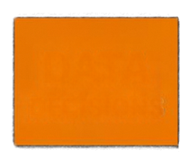
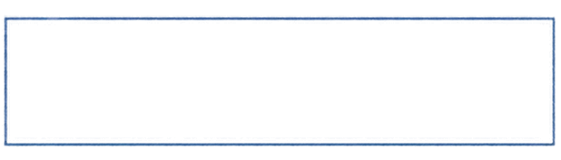
PREPROCESSING
IMPLEMENTATION
80%
Training set: 10,281 rows
Test set: 2,571 rows (20%)
TRAIN
FIT ON
Preprocessing steps were learned
using training data only
TRAIN
Applied median and mode imputation, dummy encoding, and zero-variance
feature removal to training data, then
applied the same transformations to test set
APPLY
TRANSFORMS
Extreme target values were retained
DATA
Excluded 120 SHS schools with missing
target values due to structural reasons
DECISIONS

Slide 8



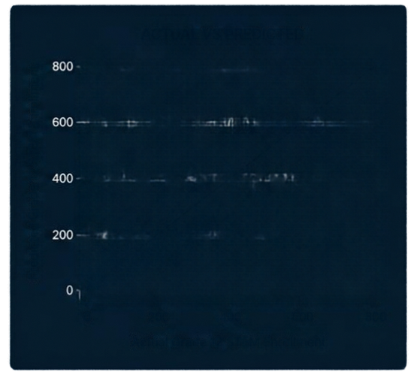
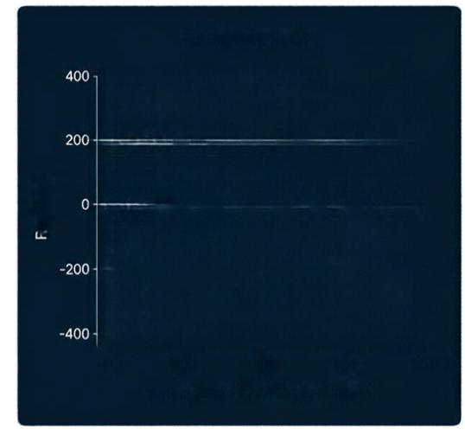

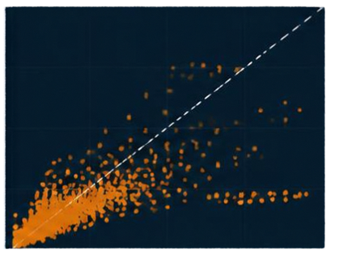
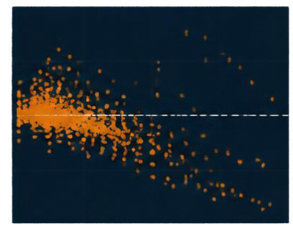
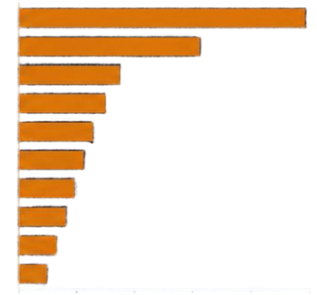
RESULTS AND
MODEL EVALUATION
EVALUATION METRICS ON TEST SET
22.98
9.77
Not reported
Compared Linear Regression with Random Forest Regression (500 trees)
Model performs well for typical schools
Large errors on rare high enrollment schools increase RMSE
Top predictors are prior year STEM enrollments and related tracks
RMSE
MAE
inflated by large errors on rare high enrollment schools
indicates
average error
~10 students
R-squared
ACTUAL VS PREDICTED
RESIDUAL PLOT
TOP 10 VARIABLE IMPORTANCE
g11_stem_male
g11_stem_female
g11_abm_male
g11_abm_female
g11_humss_male
g11_humss_female
g11_gen_male
g11_gen_female
g10_stem_male
sector_Public
Residuals
Actual Grade 12 STEM Enrollment
Actual Grade 12 STEM Enrollment
Relative Importance

Slide 9


LIMITATIONS
AND RISKS
Zero inflation and right-skewed enrollment
Selection bias from filtering SHS schools
Model tends to underpredict extreme cases
Outliers affect error metrics; no R-squared

Slide 10

REFERENCES
Department of Education (DepEd) Philippines school-level data
deped.gov.ph
Additional modeling and
methodological references
All Machine Learning algorithms

